Slide 1
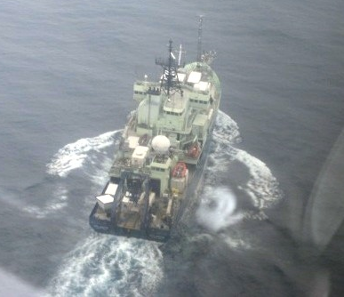
Hydrocarbons measured aboard the R/V Atlantis during CalNEX 2010
J.B. Gilman, D. Bon, W.C. Kuster, J.A. de Gouw,
B.M. Lerner, and E.J. Williams
NOAA Earth System Research Laboratory
CIRES at Univ. of Colorado, Boulder, CO
Atlantis from WP-3D
VOC Instrumentation
Airmass classifications and characterization
Comparison of CalNex VOC datasets
Oxidation chemistry
Photo: S. Lance

Slide 2
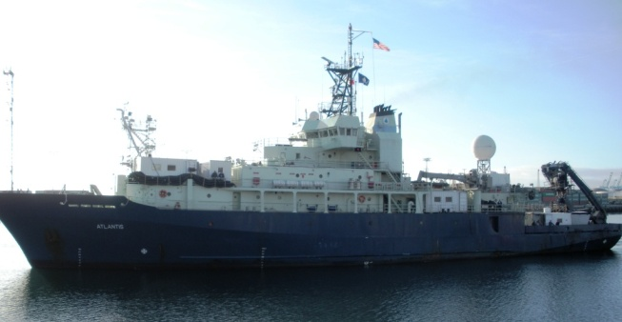
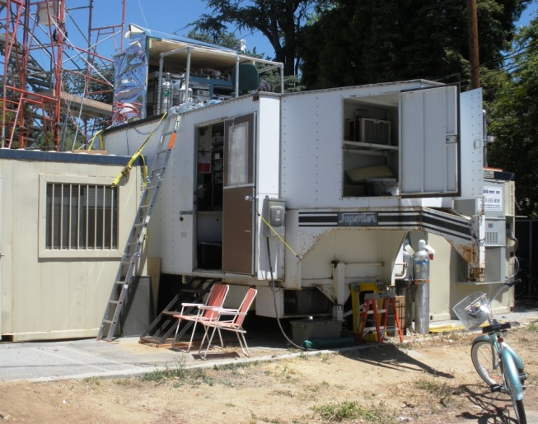
VOC datasets for CalNEX 2010
R/V Atlantis
GC-FID: C2 – C8 Hydrocarbons, Benzene, Toluene
5 min average every 30 min
PTR-TOF-MS: Aromatics, OVOCs, etc. in real time
CalTech Site in Pasadena, CA
GC-MS: C2 – C12 Hydrocarbons, Aromatics, OVOCS, ...
5 min average every 30 min
PTR-IT-MS: Aromatics, OVOCs, etc. in real time
Several CIMS: Organic/Inorganic acids, etc.
NOAA WP-3D
WAS: C2 – C8 Hydrocarbons, Aromatics, etc.
PTR-MS: Aromatics, OVOCs, etc. in real time
http://www.esrl.noaa.gov/csd/calnex/

Slide 3
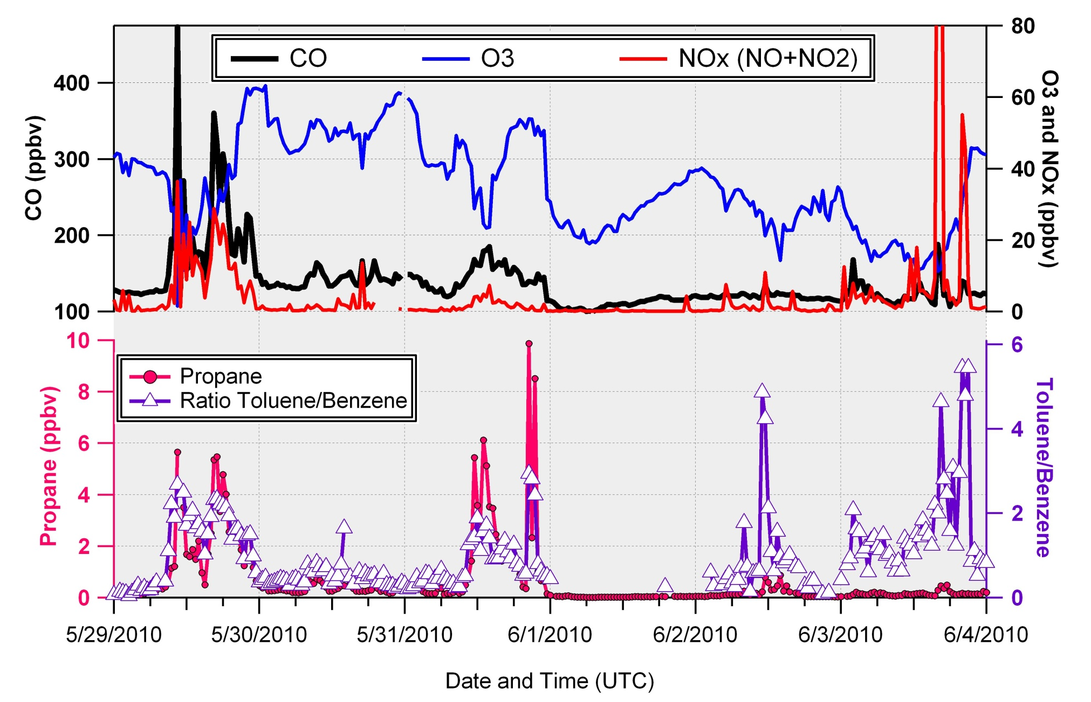
Classification of air masses via gas-phase markers

Slide 4
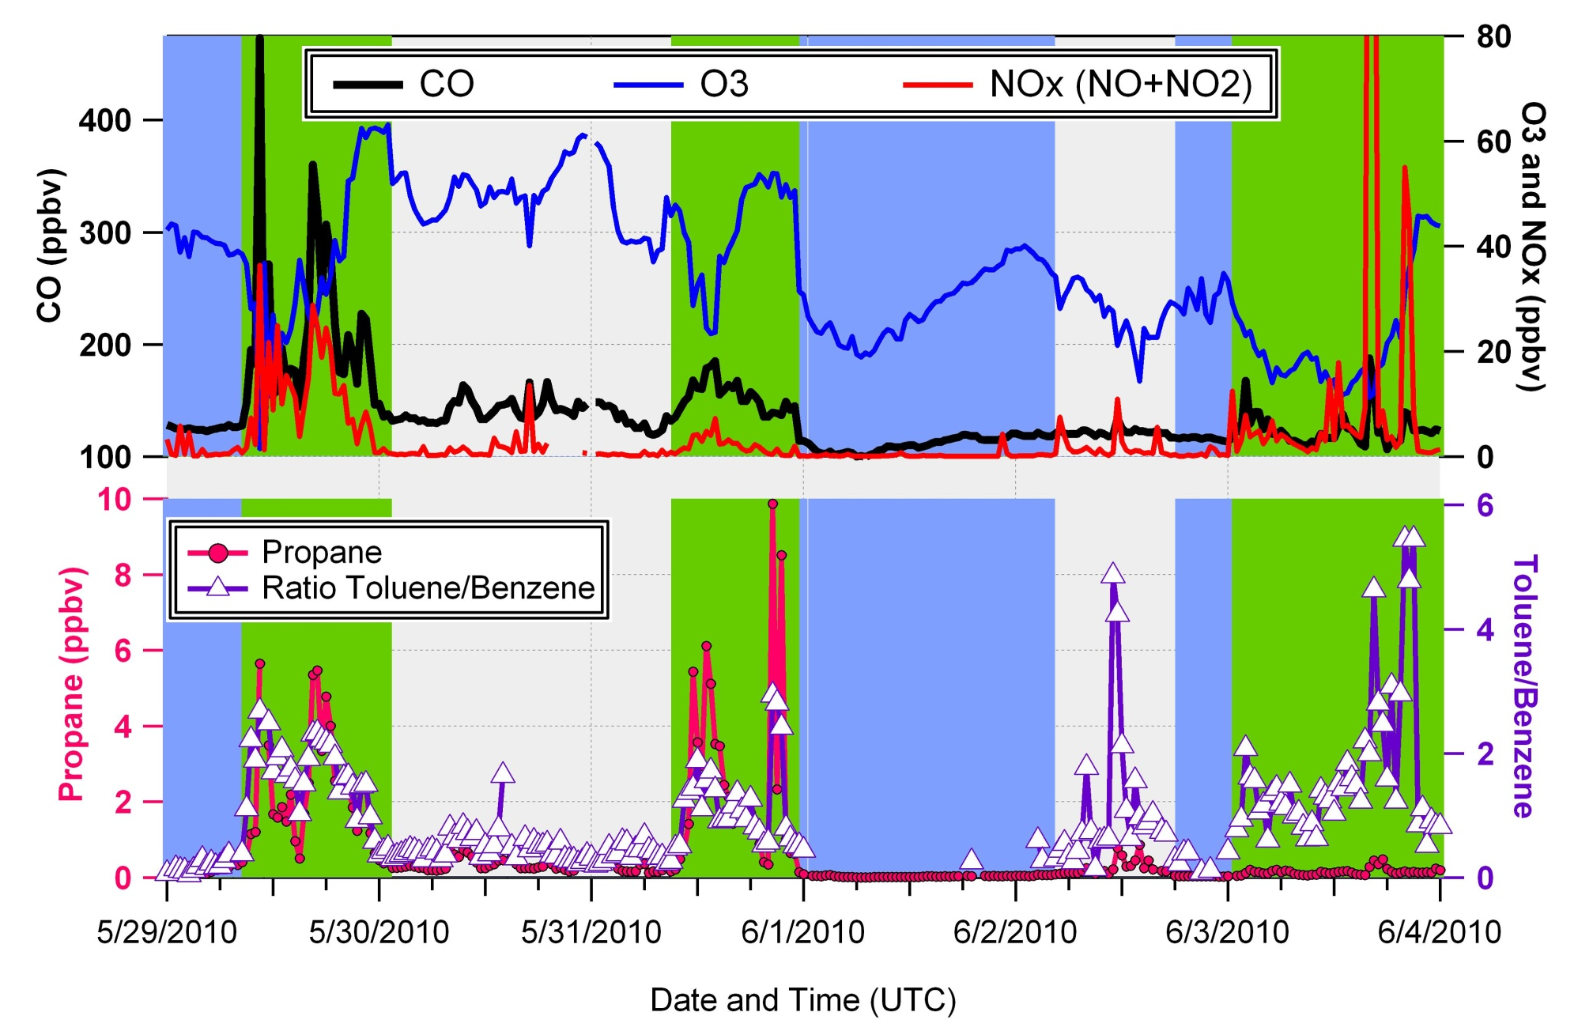
Classification of air masses via gas-phase markers
Santa Monica Bay
Santa Barbara
SF Bay to Sacramento
Transit North
Urban
Outflow
Clean
Marine

Slide 5
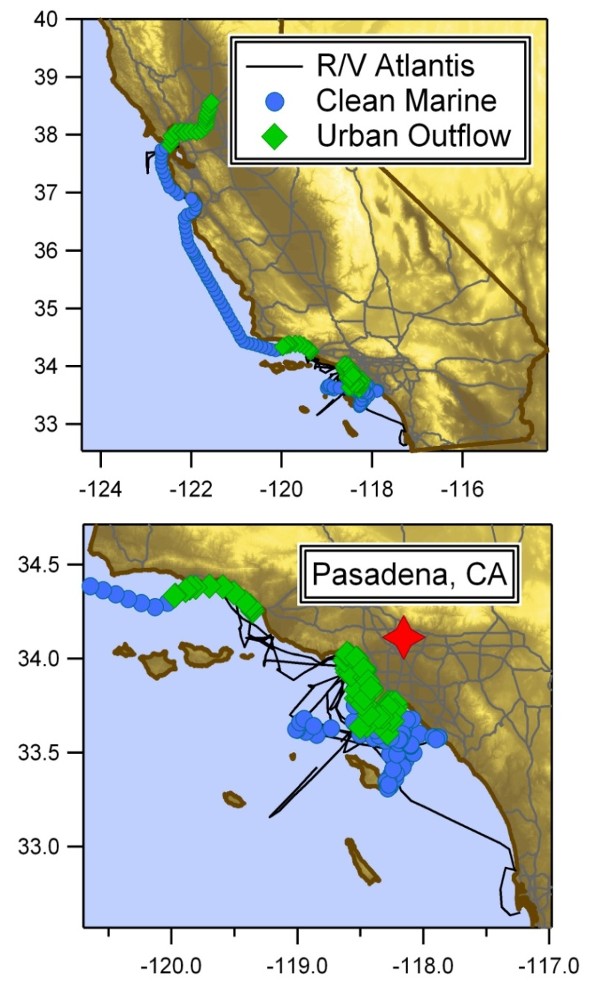
Classification of air masses via gas-phase markers
Clean Marine:
Low CO, NO_{x}, Radon
Low VOCs
Small Toluene/Benzene ratio
Typically < 1.0
Northern CA
Urban Outflow:
Increased CO, NO_{x}, Radon
O₃ anti-correlates with NO_{x}
Increased VOCs, correlate with CO
Larger Toluene/Benzene ratios
Usually > 2.0
Atlantis Exhaust/Ship Air:
Relative WD
Large CO and NO
Spike in Toluene, low VOCs
Ship hits have been removed
LA Basin

Slide 6
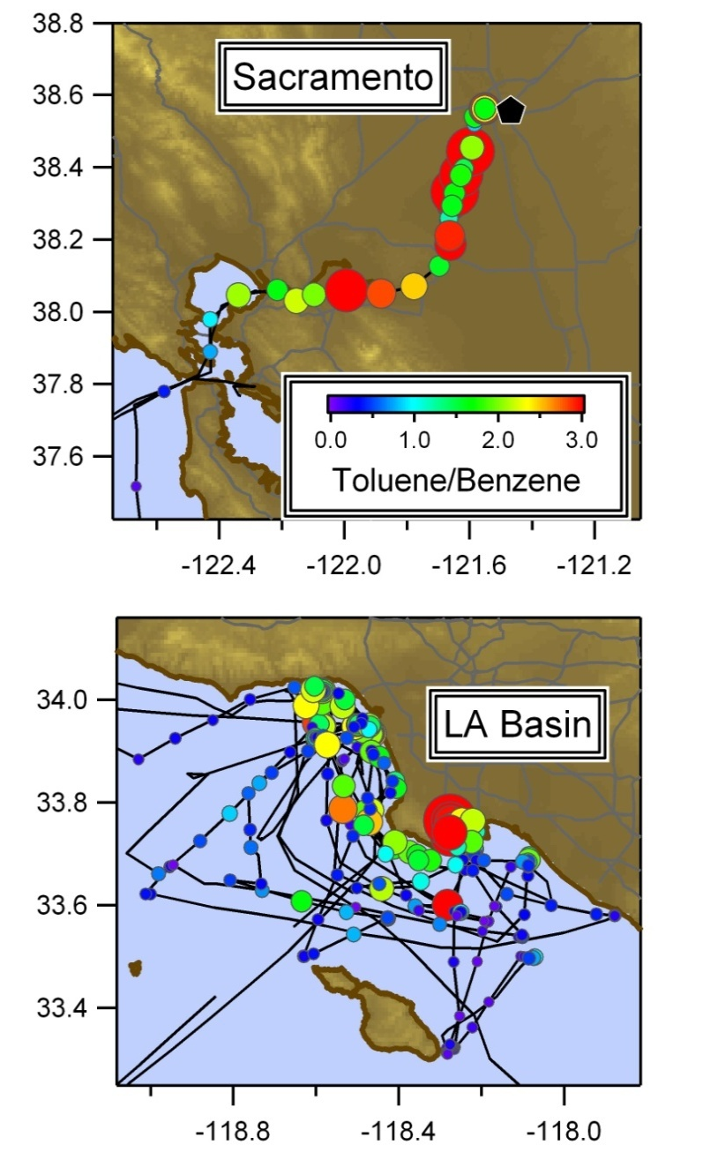
Classification of air masses via gas-phase markers
Clean Marine:
Low CO, NO_{x}, Radon
Low VOCs
Small Toluene/Benzene ratio
Typically < 1.0
Urban Outflow:
Increased CO, NO_{x}, Radon
O₃ anti-correlates with CO, NO_{x}
Increased VOCs, correlate with CO
Larger Toluene/Benzene ratios
Usually > 2.0
Atlantis Exhaust/Ship Air:
Relative WD
Large CO and NO
Spike in Toluene, low VOCs
Ship hits have been removed

Slide 7
Clean Marine
Northern CA
LA Basin
Pasadena, CA
10
Alkanes
10
Alkenes
1
1
0.1
0.1
0.01
0.01
0.001
0.001
Propane
iButane
nButane
nPentane
Ethene
Propene
1-Butene
Median Mixing Ratios (ppbv) – LOG scale
10
Other VOCs
1000
Tracers
1
100
0.1
10
0.01
1
0.001
0.1
Ethyne
Benzene
Toluene
Tol/Benz
Ozone
CO
NOx
Notes:
Note log scale.
Pasadena has the highest median mixing ratios, clean marine the lowest. Northern CA has lower VOCs and tracers than LA basin (but that could be due to the number of samples).

Slide 8
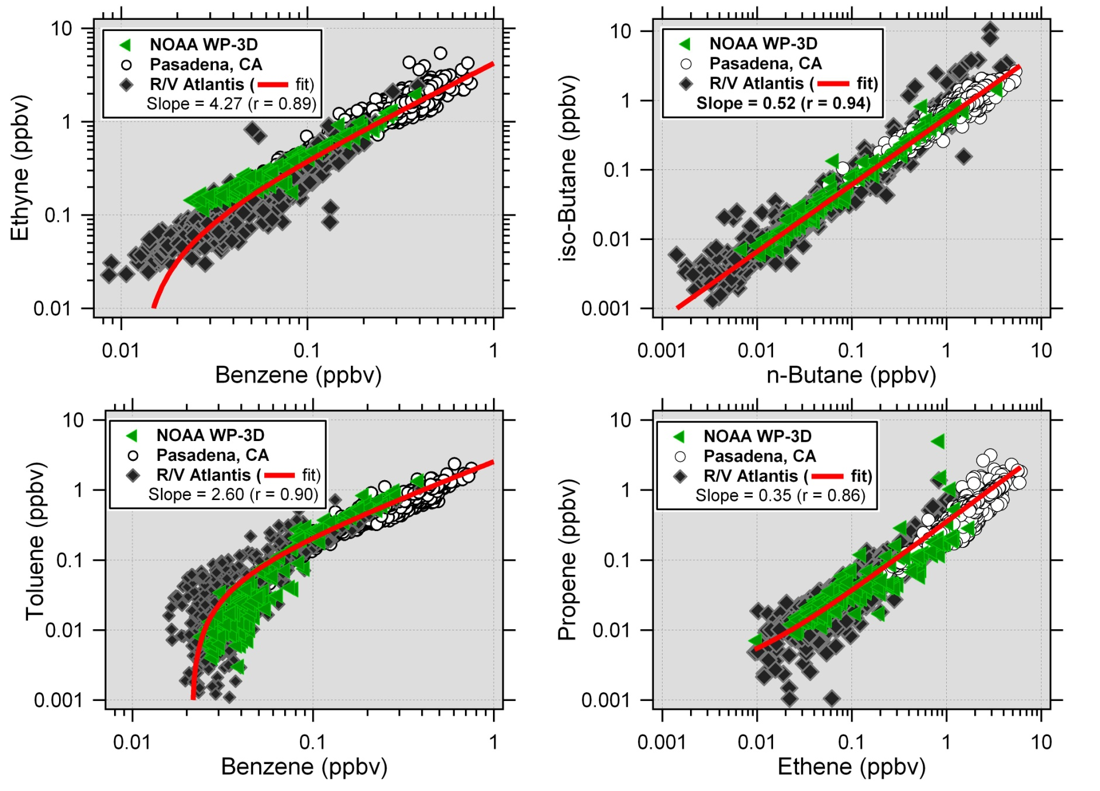
How well do the CalNEX VOC datasets compare?
VOCs (WP-3D) = D. Blake and E. Atlas
Notes:
Ethyne might be ~10% lower for atlantis and ~ 10% higher for WP3.
Very few benzene samples below 100 ppt. Ship data increases the ambient VOC ranges by an order of magnitude.
Datasets compare well. NOAA data for a few select days and only below 1km altitude.
Why does T/B curve down? Shouldn’t it curve up?

Slide 9
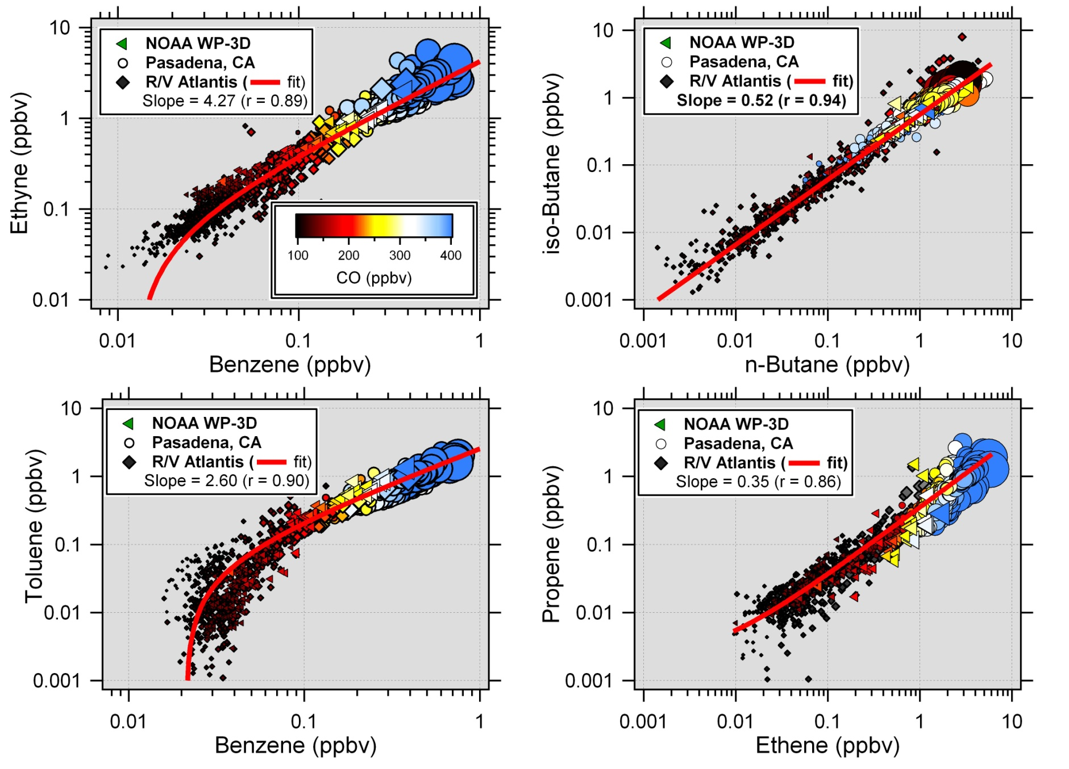
How well do the CalNEX VOC datasets compare?
All 3 platforms show similar trends for urban/combustion tracers
VOCs (WP-3D) = D. Blake and E. Atlas ; CO (WP-3D) = J. Holloway ; CO (Pasadena) = B. Lefer
Notes:
Combustion tracers follow best with CO, Butane correlation with CO is weaker because of the different sources of the two compounds.

Slide 10
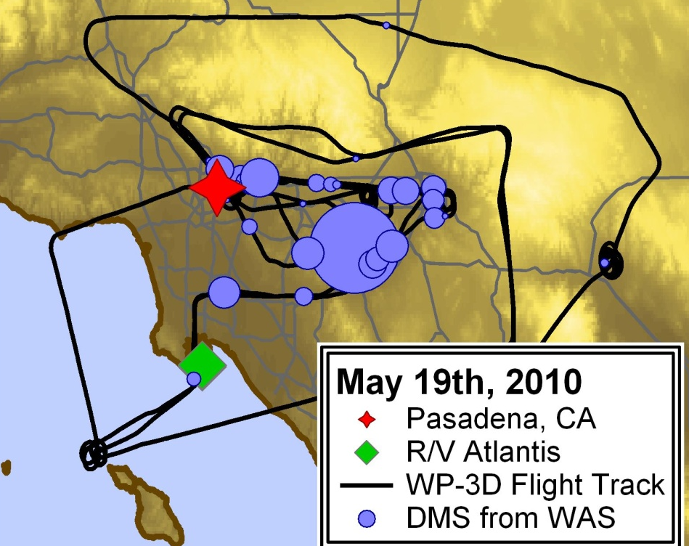
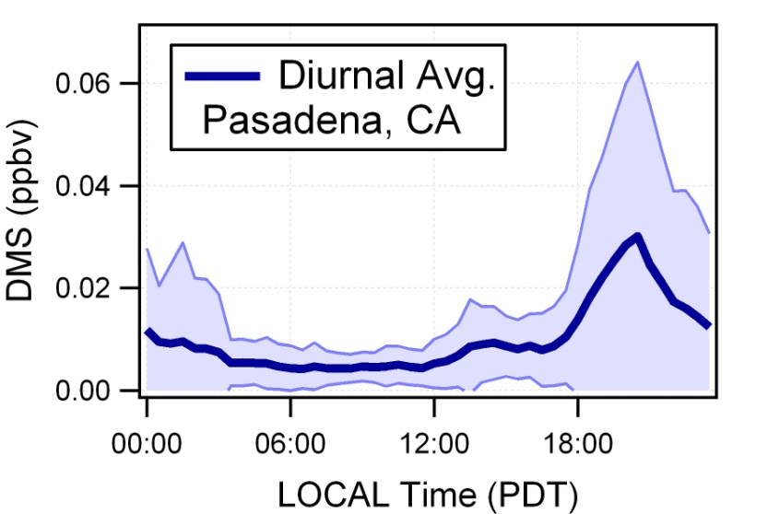
How well do the CalNEX VOC datasets compare?
Wind Rose for Pasadena, CA
20%
10%
Wind
Warm colors = higher WS (m/s)
Marine tracers (e.g., DMS) were
measured at the inland sites
All three data sets will provide valuable information regarding transport and processing
Notes:
Correlations of VOCs match well because we are studying the same source region for much of the campaign.
Wind rose and ship track overlap. LA in the middle.
Pasadena DMS shows that the ground site is exposed to oceanic sources as the atlantis is exposed to urban sources.
Even the WP3 shows the transport of DMS throughout the LA basin under specific atmospheric conditions.

Slide 11
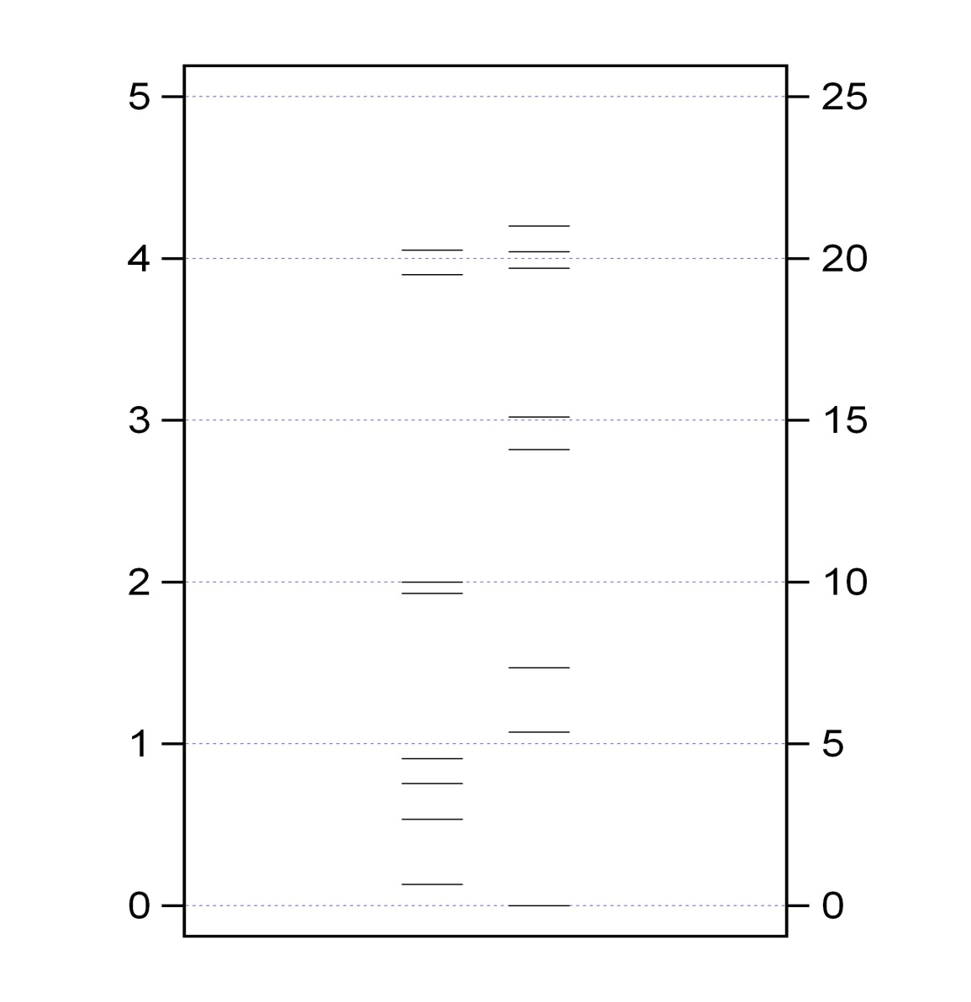
What can VOCs tell us about oxidation chemistry?
Oxidation of VOCs can lead to the production of O₃
VOCs react with OH and Cl
- d[VOC]/dt = k_{OH}[OH]+k_{Cl}[Cl]
[OH] >> [Cl]
k_{OH} < k_{Cl}
Changes in VOC ratios can be used to decipher oxidation chemistry
Ratios are less sensitive to mixing and dilution than absolute mixing ratios
k_{OH} ×10⁻¹²
k_{Cl} ×10⁻¹¹
n-Pentane
n-Pentane
iso-Pentane
iso-Pentane
n-Butane
iso-Butane
Propane
Reaction Rate Coefficients (cm³ molec⁻¹ s⁻¹)
n-Butane
iso-Butane
Acetylene
Benzene
Ethane
Propane
Acetylene
Ethane
Benzene
Parrish, et al. (1992), Helmig, et. al (2008)

Slide 12
What can VOCs tell us about oxidation chemistry?
Gilman, et al. [2010]
2008 IPY decreases in:
[n-Butane]/[i-Butane] → Cl
[Acetylene]/[Benzene] → Cl + Br
- Well mixed air masses
- OH oxidation was negligible
2010 CalNEX:
- Influence of local sources
- Mixing of air masses of varying
photochemical ages
- OH oxidation is NOT negligible

Slide 13
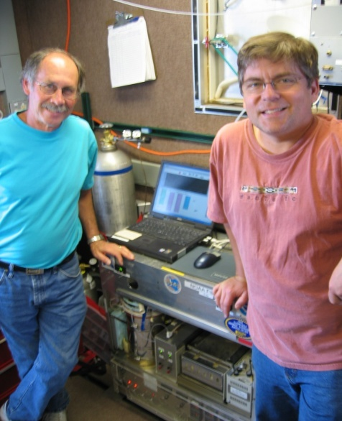
Summary
Air mass classifications and characteristics
Clean Marine: [Toluene]/[Benzene] < 1.0
Urban Outflow: [Toluene]/[Benzene] > 2.0
Few interesting “intermediate” cases to look into
VOC measurements from all platforms compare well
VOC data sets will provide valuable insight regarding
transport and degree of air mass processing
What’s next?
Investigate the relative influence of
OH and Cl oxidation chemistry in
the processing of urban/marine air
Thanks to Dan, Bill, and fellow scientists and crew
Jessica.Gilman@noaa.gov

